Slide 1
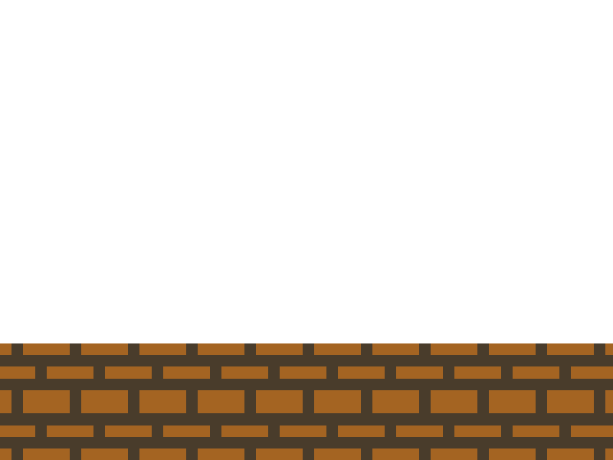
Automatic Game Script Generation
by Ahmed Abdel Samea Khalifa
Suppervised by Prof. Magda Fayek

Slide 2


Agenda
Introduction
Background
Level Generation
  Literature Review
  Methodology
  Results
Rule Generation
  Literature Review
  Methodology
  Results
Conclusion & Future Work

Slide 3
Introduction

Slide 4
Introduction

Slide 5
Background

Slide 6
Background
Puzzle Games
Procedural Content Generation (PCG)
  Level Generation
  Rule Generation
Search based PCG
  Search Algorithm
  Content Representation
  Evaluation Function

Slide 7
Background
Puzzle Script as Video Game Description Language (VGDL)
  Objects
  Legend
  Sounds
  Collision Layer
  Rules
  Win Conditions
  Levels

Slide 8
Level Generation

Slide 9
Literature Review
Sokoban
Fruit Dating
Cut the Rope
KGoldRunner
Refraction

Slide 10
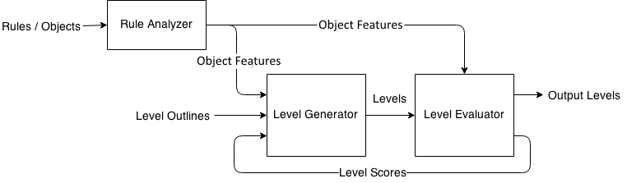
System Architecture

Slide 11
Rule Analyzer
Generate object features
Each object is assigned 6 different features
  Type
  Subtype
  Priority
  Behaviors
  Minimum Number
  Relations

Slide 12
Type
Base on object position in file
  Rule Object
  Player Object
  Winning Object
  Solid Object
[ > | ] -> [ > | > ]
Player
Crate
Player
Crate
All on
Target
Crate
Background
Target,
Player, Crate,
Spike
Wall

Slide 13
Subtype
Base on relation with rules
  Critical Object
  Normal Object
  Useless Object
[ > | ] -> [ > | > ]
[ | Gem | ] -> [ | | ]
[ > | ] -> [ | ]
[ > | ] -> [ | ]
No Target on Gem
Player
Crate
Player
Crate
Crate
Crate
Crate
Stopper
Crate
Stopper
Wife Lava

Slide 14
Priority
Number of Rules for each Object
[ > Player | Crate ] -> [ > Player | > Crate ]
[ > Crate | Crate ] -> [ > Crate | > Crate ]
[ Crate | Crate | Crate ] -> [ | | ]
[ > Crate | Stopper ] -> [ Crate | Stopper ]
All Player on Target
Crate | Player | Stopper | Target
4 | 2 | 1 | 1

Slide 15
Behaviors
Four different Behaviors
  Move
  Teleport
  Create
  Destroy
Objects can have more than one Behavior
[ > Player | Crate ] -> [ > Player | > Crate]
[ > Player | Crate ] -> [ Crate | Player ]
[ > Player | ] -> [ Crate | Player ]
[ > Player | Crate ] -> [ | Player ]

Slide 16
Minimum Number
Maximum number of an object in all rules
Minimum number of an object in Create rules
[ > Player | Crate ] -> [ > Player | > Crate ]
[ > Crate | Crate ] -> [ > Crate | > Crate ]
1
2
Crate Minimum Number: 2
[ > Player | ] -> [ Crate | Player ]
[ > Crate | Crate ] -> [ > Crate | > Crate ]
[ Gem | Crate | Gem ] -> [ Crate | Crate | Crate]
0
2
1
Crate Minimum Number: 0

Slide 17
Relations
List of all objects connected with a certain object
Special list for Left Hand Side (LHS)
[ > Player | Crate ] -> [ > Player | > Crate ]
[ > Crate | Lava ] -> [ | ]
All Target on Player
Player | Crate, Target
Crate | Player, Lava
Lava | Crate
Target | Player

Slide 18
Level Generator
Constructing a level from the input layout
Two different approaches
  Constructive Approach
  Genetic Approach

Slide 19
Constructive Approach
Uses an algorithm to generate levels
Algorithm utilizes object features
Algorithm is divided into two parts
  Calculating numbers
  Inserting objects

Slide 20
Calculating Numbers
Object numbers equals to its percentage in the game
Perecentage are calculated for
  Winning Objects
  Critical Objects
  Rule Objects
  Solid Objects
For example:
2 Objects with min 1
1 Object with min 3
1 Object with min 1
1 Object with min 1
Winning Objects | Critical Objects | Rule Objects | Solid Object
2 / 7 | 3 / 7 | 1 / 7 | 1 / 7

Slide 21
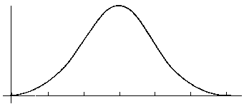
Calculating Numbers
Cover Percentage is inversly propotional to
  Critical objects percentage
  Winning objects percentage
Boring
Frustration
Intersting
Winning and Critical Objects Perecentages

Slide 22
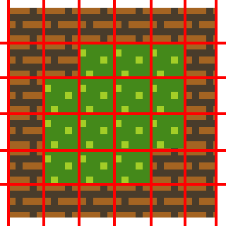
Inserting Objects
4
Based on Object Behaviors
  Move Behavior
  Others
Number of inserted objects are multiple of its Minimum Number feature
Winning Objects
  Equal Amount unless Create
  Same position in "No" winning condition
1
0

Slide 23
Inserting Objects
Critical Objects
  All objects are inserted
  Remaining according to Priority feature
Rule Objects
  Selected based on Priority feature
[ > Player | Crate ] -> [ > Player | > Crate ]
[ Crate | Crate | Crate ] -> [ | Gem | ]
Some Gem on Target

Slide 24
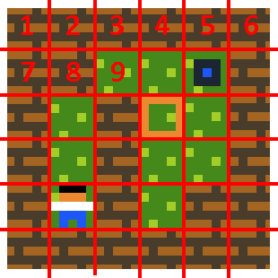
Genetic Appraoch
Uses Genetic Algorithm (GA)
Chromosome Representation

Slide 25
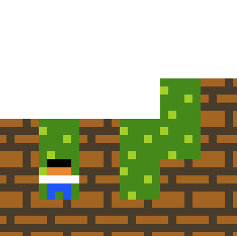
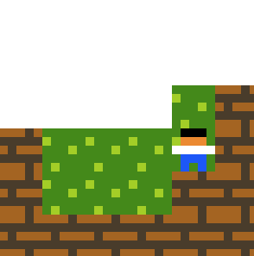
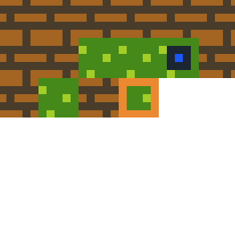
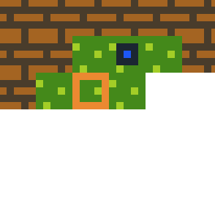
CrossOver
CrossOver Point
Chromosome 1
Chromosome 2

Slide 26
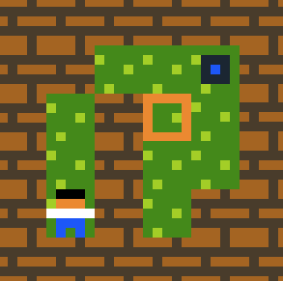


Mutation
Delete Mutator

Slide 27

Mutation
Create Mutator

Slide 28
Mutation
Swap Mutator

Slide 29
Intial Population
Random Initialization
Constructive Initialization
Mixed Initialization
  25% Constructive Initialization
  25% Mutated Constructive Initialization
  50% Random Initialization

Slide 30
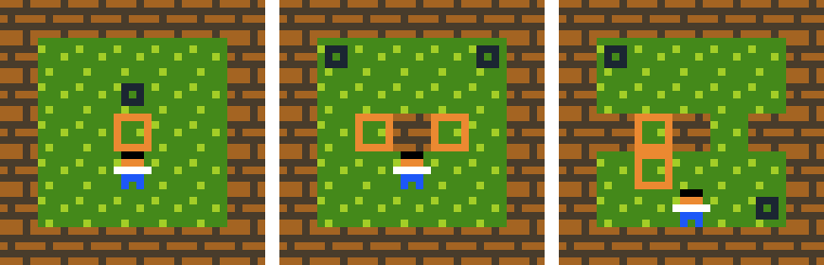
Level Evaluator
Evaluate Generated Levels
Use an Automated Player for Playability
Use Heuristics Measures for Challenging

Slide 31
Automated Player
Modified version of Lim et al. Automated Player
Uses similar algorithm to A* called BestFS

Slide 32
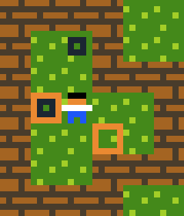
Original Player
Distance between Winning Objects
Distance between Player and Winning Objects

Slide 33
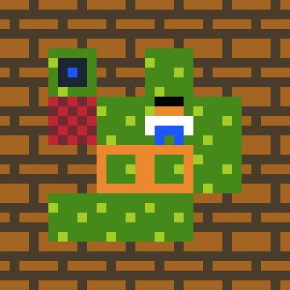
New Player
Problem with Player as Winning Object
Explained in rules
[ > Player | Crate ] -> [ > Player | > Crate]
[ > Crate | Lava ] -> [ | ]
Player | Crate
Crate | Lava

Slide 34
Output of New Player
Best State Score
Movement Sequence
Number of Explored States
Number of Applied Rules

Slide 35
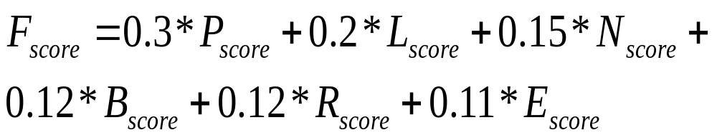
Heuristic Measures
Weighted Function of Six Attributes
Weights are calculated experimentaly to ensure best output

Slide 36

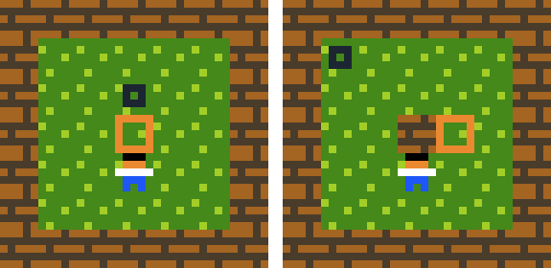
Playing Score (P_{score})
Difference between Best State Score and Initial Level Score
Inspired from Nielsen et al. work
Left Image Difference < Right Image Difference

Slide 37
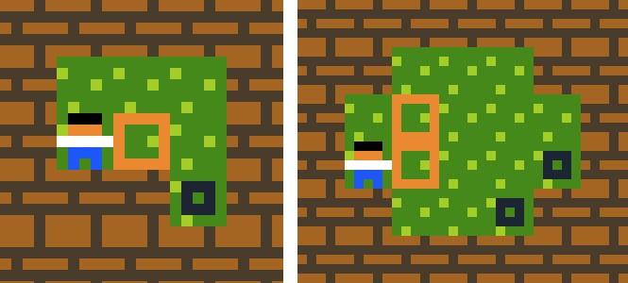
Solution Length Score (L_{score})
Longer Solution Length is better
Very Long Solution Cause Frustration
Solution Length depends on Level Area
Solution Length = 4
Solution Length = 17

Slide 38
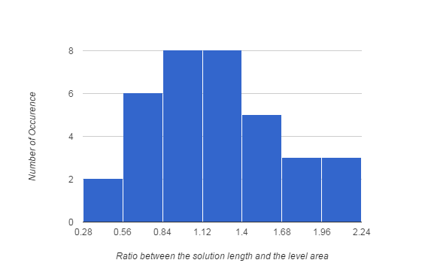
Solution Length Score (L_{score})
40 Hand Crafted Levels are Analyzed
Normal Distribution: μ = 1.221 and σ = 0.461

Slide 39
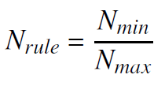
Object Number Score (N_{score})
Number of Rule Objects
Objects: Crate, Wall, Player, Target
Generated: Crate, Wall, Player
Score: 3 / 4

Slide 40

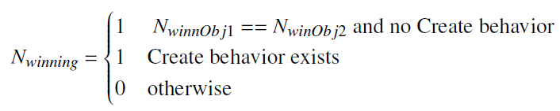
Object Number Score (N_{score})
Number of Players
Number of Winning Objects

Slide 41
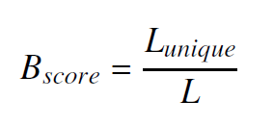
Box Line Score (B_{score})
Used in Taylor and Parberry research in generating Sokoban levels
Up, Up, Up, Left, Left, Down
Score: 3 / 6

Slide 42
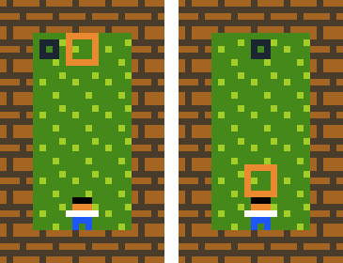
Applied Rule Score (R_{score})
More Applied Rules is Better Level
Excessive Applying rules is Boring
Percentage = 1 / 8
Percentage = 1

Slide 43
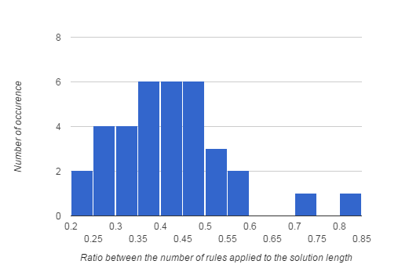
Applied Rule Score (R_{score})
40 Hand Crafted Levels are Analyzed
Normal Distribution: μ = 0.417 and σ = 0.128

Slide 44
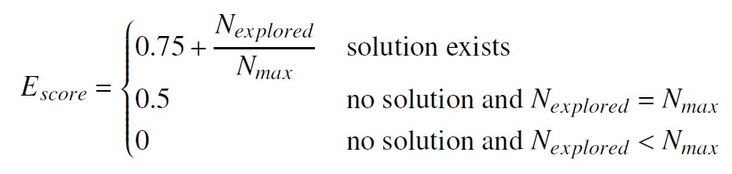
Exploration Score (E_{score})
More Exploration is More Challenging
Solution Matters

Slide 45
Results

Slide 46
Rule Generation

Slide 47
Literature Review

Slide 48
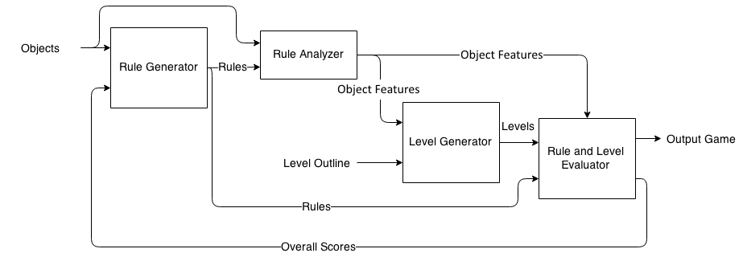
System Architecture

Slide 49
Rule Generator
Uses GA as in Lim et al. Work
Added Winning Condition
Chromosome Representation
  Group of rules of minimum 1 and maximum 4
  Winning Condition
[ > Player | Crate ] -> [ > Player | > Crate ]
[ > Crate | Crate ] -> [ > Crate | > Crate ]
All Target on Crate

Slide 50
CrossOver
Number of rules are equal
Number of tuples are equal
Number of Objects are equal
[ > Player | Crate ] -> [ > Player | > Crate ]
[ > Crate | Crate ] -> [ > Crate | > Crate]
Uncompatible
[ > Player | ] -> [ Crate | Player ]
[ Crate Lava ] -> [ ]
Compatible
[ > Player | Crate ] -> [ > Player | > Crate ]
[ > Crate | Lava ] -> [ | ]

Slide 51
CrossOver
Hand Side CrossOver
Element CrossOver
[ > Player | > Crate ]
[ > Player | Crate ] ->
[ < Player | Lava ] ->
[ < Player | < Lava ]
[ > Player | ] -> [ < Player | < Lava ]
Crate
[ < Player | ] -> [ > Player | > Crate ]
Lava

Slide 52
CrossOver
Winning Condition CrossOver
All
Target on Crate
No
Target on Gem

Slide 53
Mutation
Rule Size Mutator
Object Mutator
Direction Mutator
[ > Player | Crate ] -> [ > Player | > Crate ]
[ > Crate | Crate ] -> [ > Crate | > Crate]
Crate
[ > Player | ] -> [ > Player | > Crate ]
Gem
[ > Player | Gem ] -> [ Player | > Crate ]
>
<

Slide 54
Mutation
Tuple Size Mutator
Hand Side Swap Mutator
Winning Condition Mutator
[
> Player |
Gem ] -> [
< Player |
> Crate ]
[ Gem ]
->
[ > Crate ]
All on Crate
Target
Gem

Slide 55

Rule and Level Evaluator
Combination between Level Evaluator and modified Lim et al. Evaluator
Weights are measured experimentaly to ensure best results

Slide 56

Rule Score (R_{score})
Combination of Heuristics Score and Validity Score
Weights are measured experimentaly to ensure best results

Slide 57
Heuristics Score (H_{score})
Similar to Lim et al. Heuristics
Consists of Eight Heuristics
All Heuristics have same weights

Slide 58
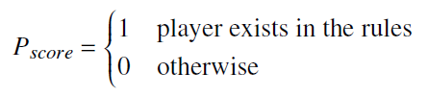
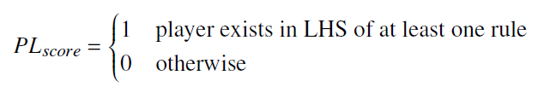

Heuristics Score (H_{score})
Player Exists
Player in LHS
Player Movement

Slide 59
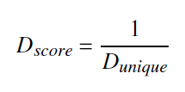
Heuristics Score (H_{score})
Direction Consistencey
[ > Player | Crate ] -> [ > Player | > Crate ]
1
[ > Player | Crate ] -> [ v Player | < Crate ]
1 / 3

Slide 60
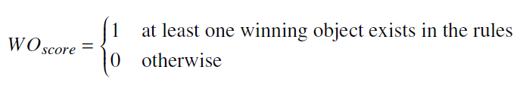
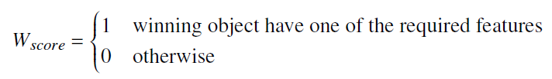
Heuristics Score (H_{score})
Winning Object in the Rules
Winning Condition Validity
All, Some | Create, Move, Teleport
No | Delete, Move, Teleport

Slide 61

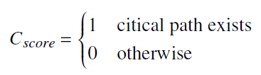
Heuristics Score (H_{score})
Useless Objects
Critical Path Exists
[ > Player | Crate ] -> [ > Player | > Crate ]
[ Crate | Crate | Crate ] -> [ | Gem | ]
Some Target on Gem

Slide 62
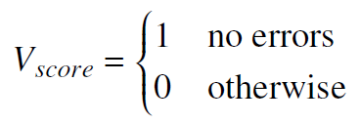
Validity Score (V_{score})
Ensure no error happens
  Compilation
  Runtime

Slide 63
Results

Slide 64
Conclusion & Future Work

Slide 65
Conclusion

Slide 66
Future Work

Slide 67

Thank You

